Slide 1

Applying the General Machine Learning Framework to Predict Outcome in Same-Year Home Resales (2010 – 2020)
By Ruslan Dubas
Data Engineer
Boalytics, LLC
YOUR BACK OFFICE ACCOUNTING & ANALYTICS TEAM
Notes:
Hello Everyone! My name is Ruslan Dubas and tonight, I will share my Integrative Project which I completed for the Masters program of Business Analytics and Information Systems at University of South Florida in Spring 2022! We will be using Florida Department of Revenue records to analyze single-family residential home same year re-sales!

Slide 2

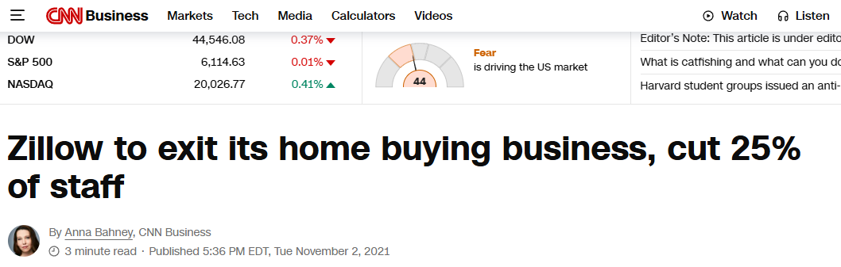
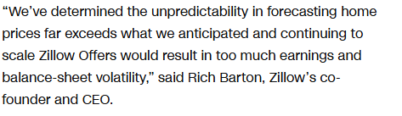





Notes:
At the half way through the program, the project update was required to be submitted. So I have read the news about Zillow exiting the home buying business and that caught my interest. I wanted to find out more about when Zillow loses money. I think I was driven by the notion that real estate market was unfair because of the presence of the for profit companies whose business is to buy homes and re-sale for higher price. So first I lookup the iBuyers which article mentioned.

Slide 3
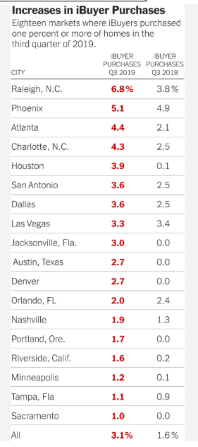

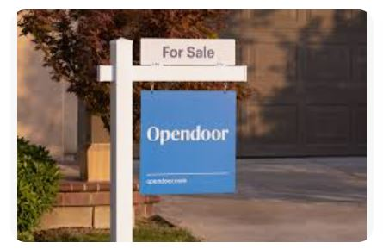



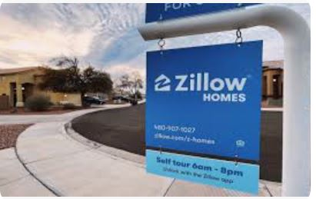
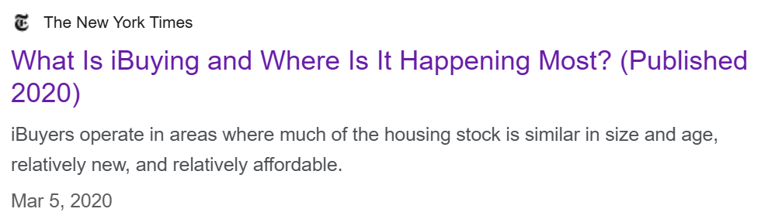
“An iBuyer, or "instant buyer," is a real estate company that uses algorithms and technology to buy and resell homes quickly. When selling a home to an iBuyer, you may get a cash offer in as little as 24 hours.”
Notes:
Article, mentioned 5 iBuyers – Opendoor, Offerpad, Zillow, Redfin and Simple Sale. So I have looked them up and put them on the pin board as my suspects to research and analyze. I thought there is a great conspiracy by them to make buying a home unaffordable and I was to uncover the truth.

Slide 4
My Research Question:
How to predict whether an investment on a Single Family Residential (SFR) Home will generate a profit or loss when re-sold within the same year?

Slide 5
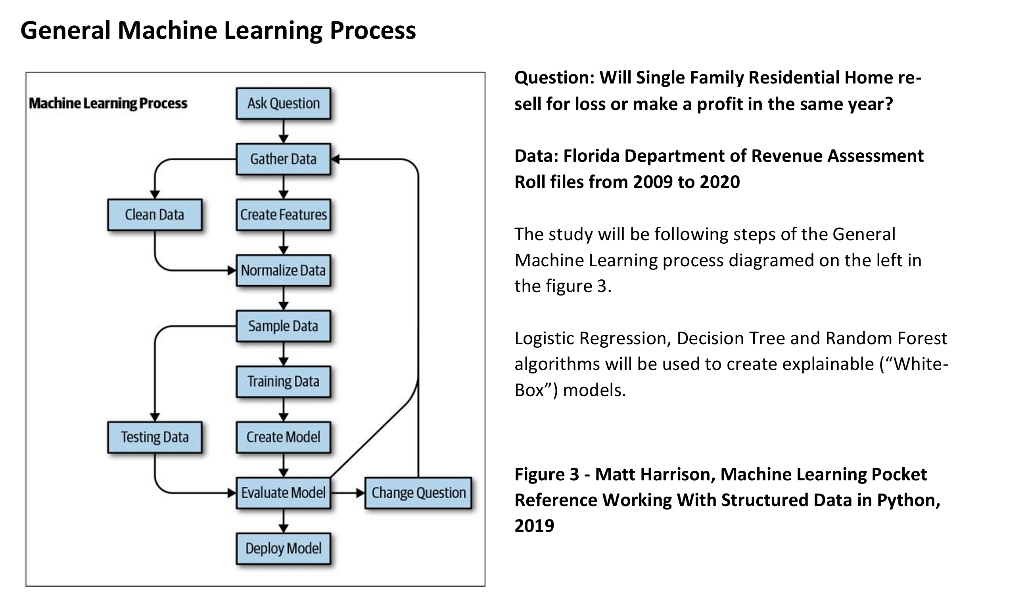

Notes:
Here is the outline of the Machine Learning Process which the study will be following. The question: Will Single Family Residential home re-sell for loss or make a profit in the same year? One of my goals was to find trends which I can use to make money! That is the power of the data analytics we can work with data to derive useful and actionable insights.

Slide 6
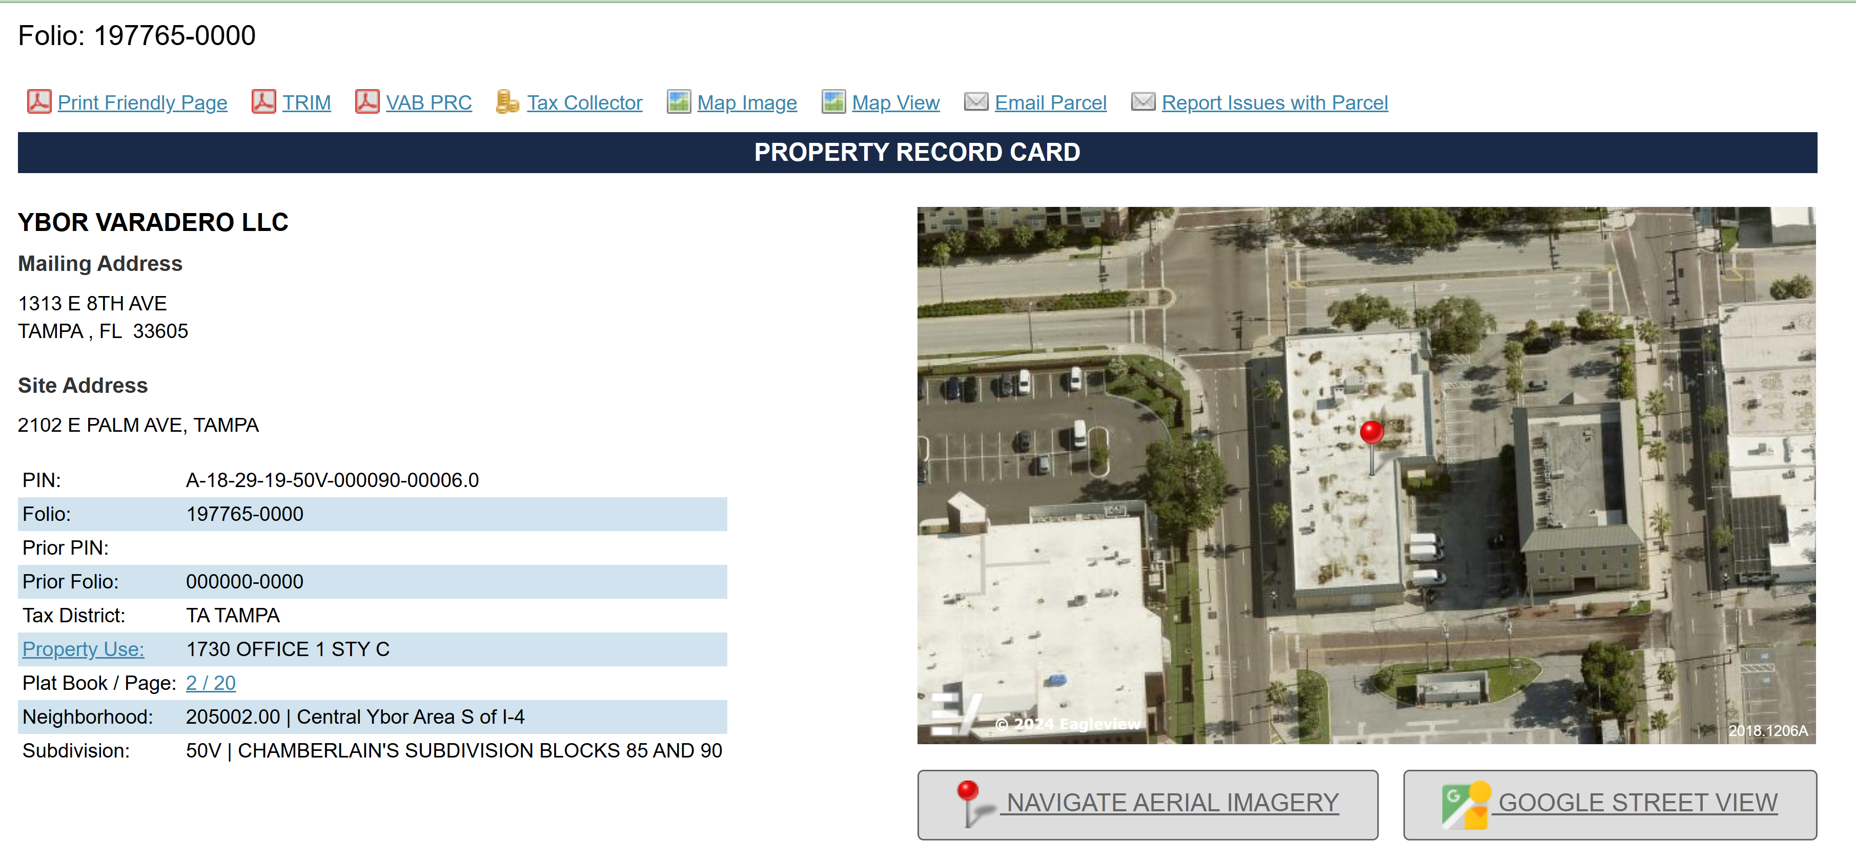
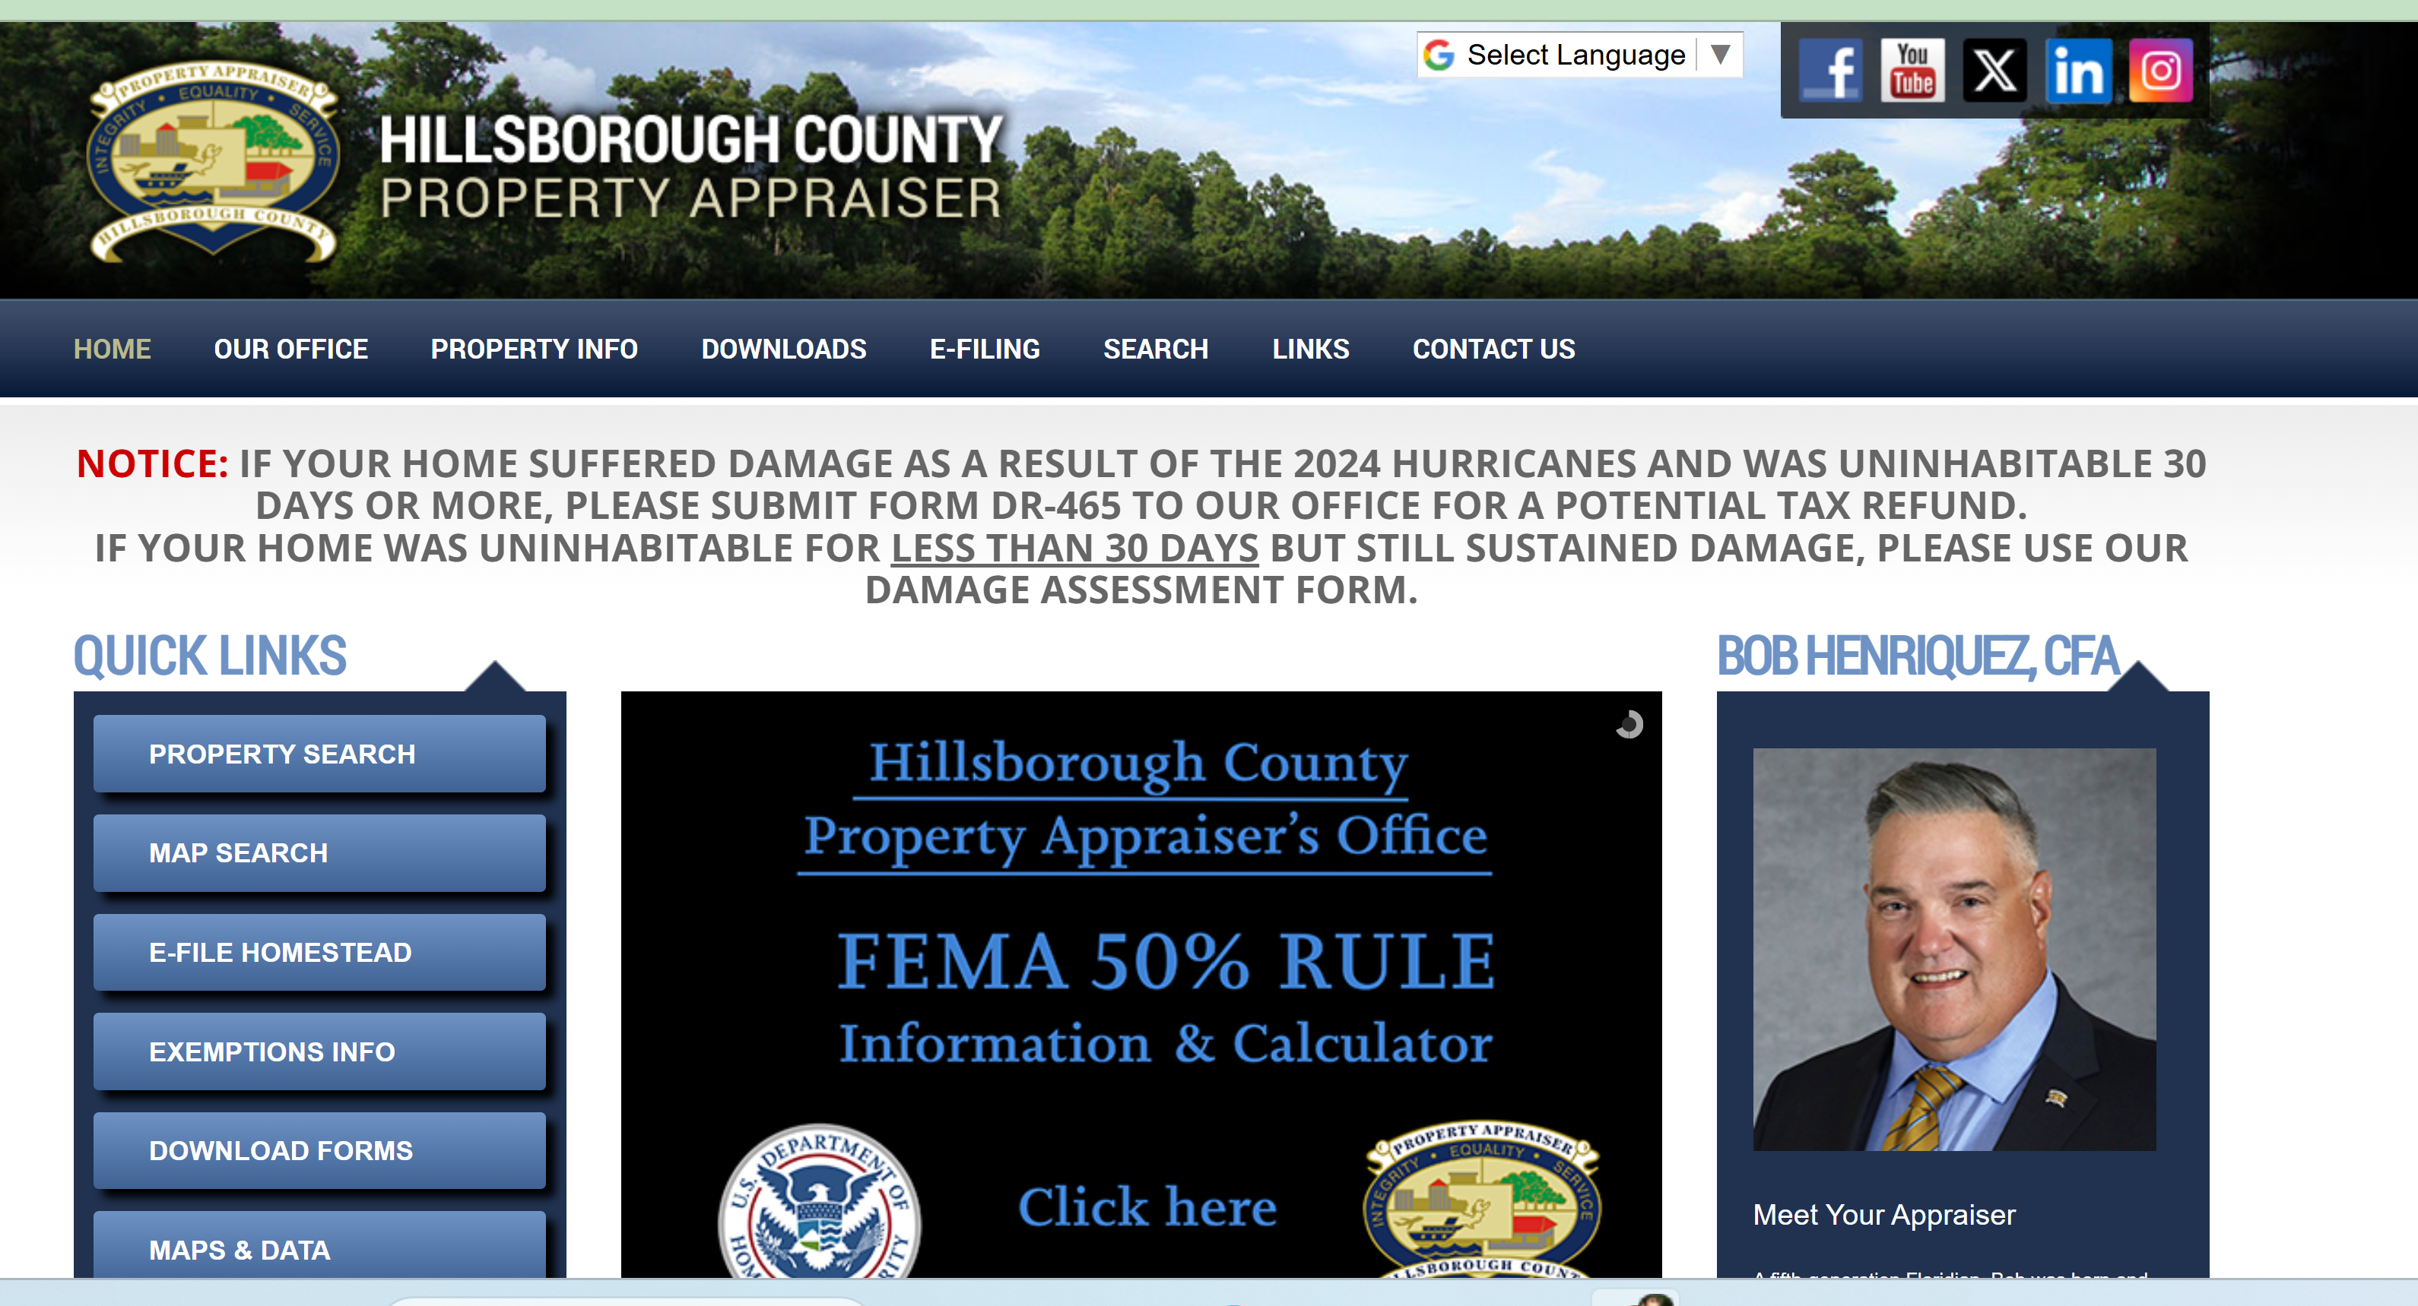

The property record card shows the property's status on each Jan 1st. Changes after that date appear on next year's record
Notes:
First I would like to introduce the data set by looking at one example of the records in it. Some of you might have entered the address into Google Maps to navigate to this meetup location. I know few other places where we can also enter this address.
One of them is Hillsborough County Property Appraiser website.
We can lookup Property Record Card of this building.

Slide 7
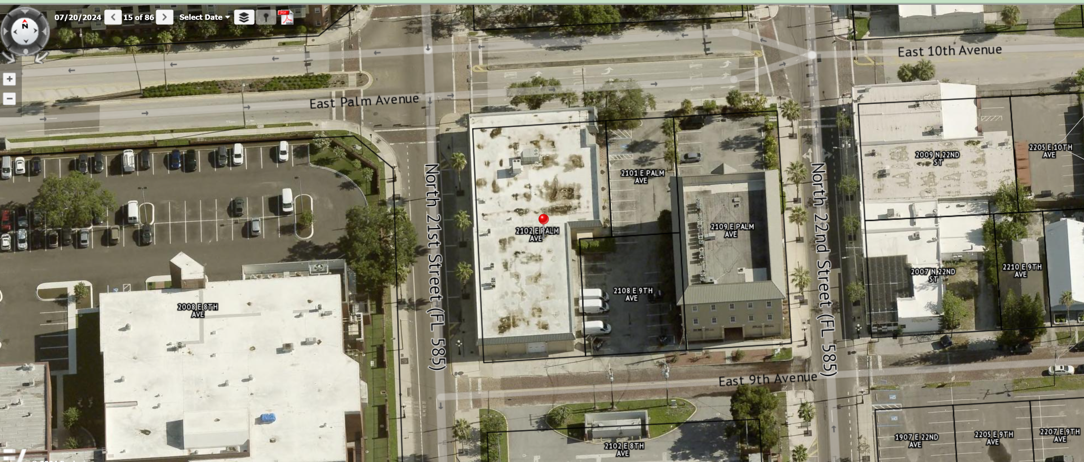
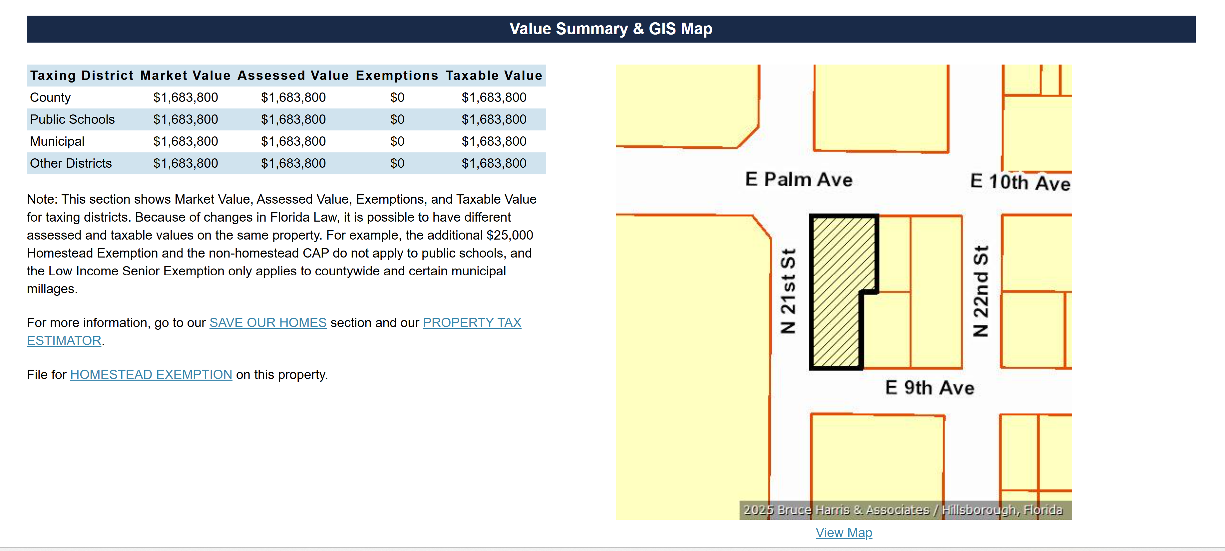
Property Record Card
Notes:
Here on this slide we can see the Market Value of this property at $1.5 million. We can see areal picture and property boundaries. In the past Property Record Card was a physical paper card filed in the cabinets. I have seen these cards and was present when they were thrown out.
Because the technology changed and everything was digitized. But rate of change is not uniformed, because some counties continue to collect data with clipboard and some already switched to the tablets. The big obstacle to the progress was the ability to have mobile internet.

Slide 8
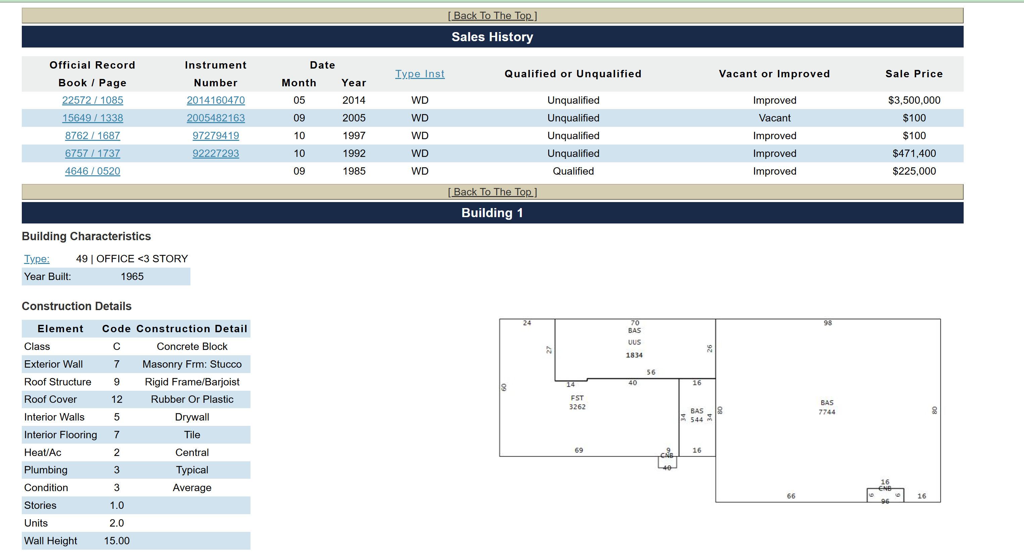









Property Record Card
Notes:
Here is the Property Record Card shows us various data points – we have Sale History and Building Characteristics.
We can see that the property was sold in 2014 for $3.5 million and sale was not qualified. We can see the type of the building – Office less than 3 stories and Year build - 1965
Also, the room we are currently in is 3200 square feet.
The Property Appraiser usually gets sales information from the Deeds recorded by County Clerk of Courts.

Slide 9
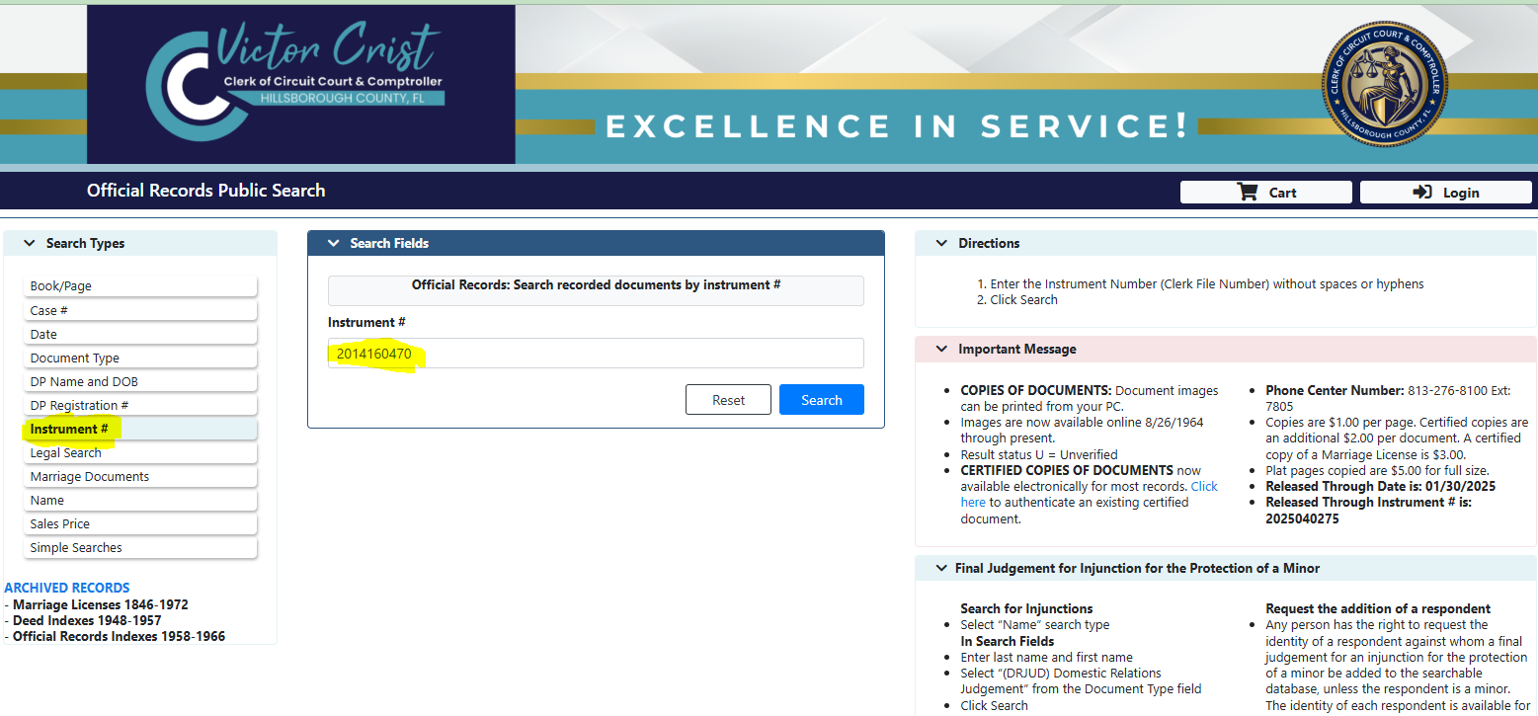
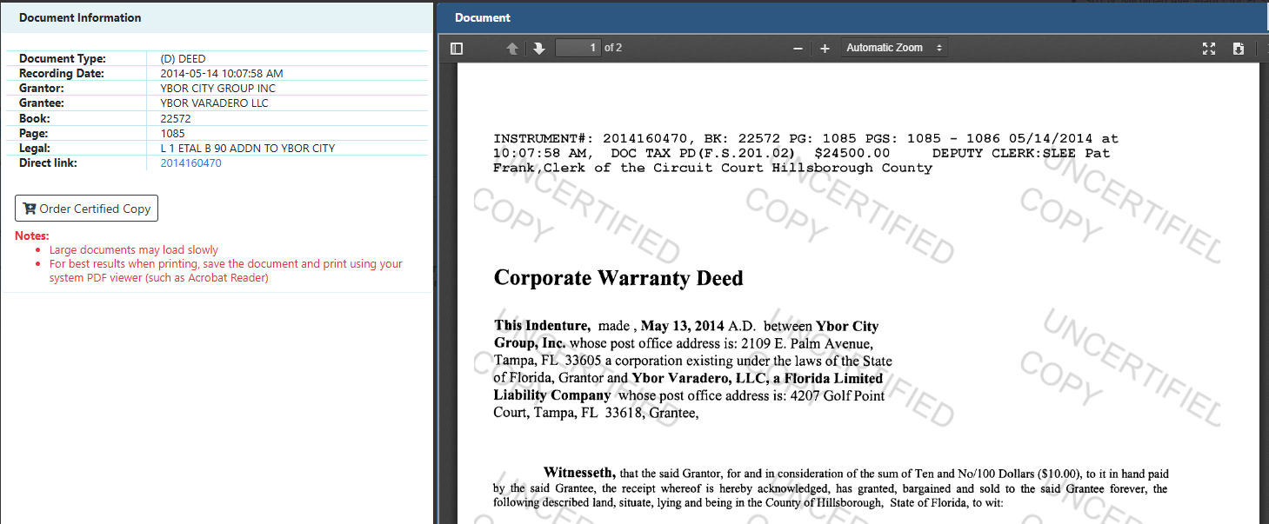
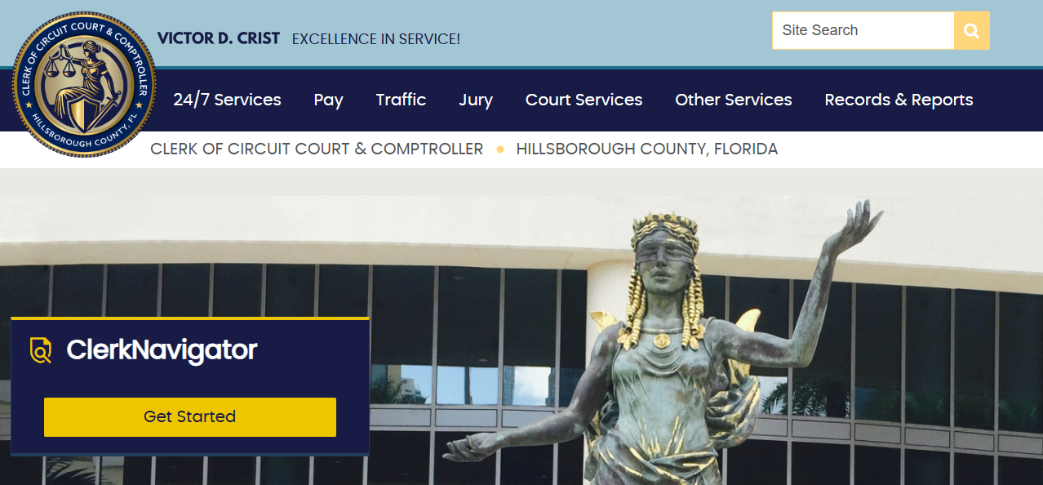



Was sale between related parties?
How to find out?
Who to contact?
Notes:
Here we are using the instrument number to quickly lookup the Deed. We also could have used the property address in pull all the legal documents associated with this property.
The Deed used by County Property Appraises to help with sale qualifications. We even can take one step further and search for the Manager or Director of the LLC listed on the Property Record Card as the owner by going to the Sunbiz Website.

Slide 10
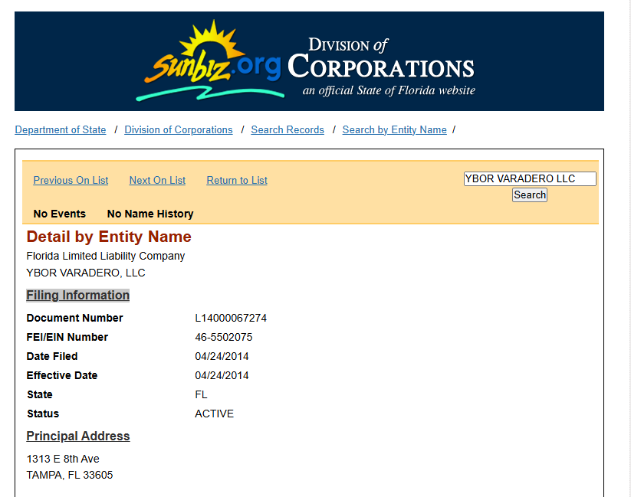
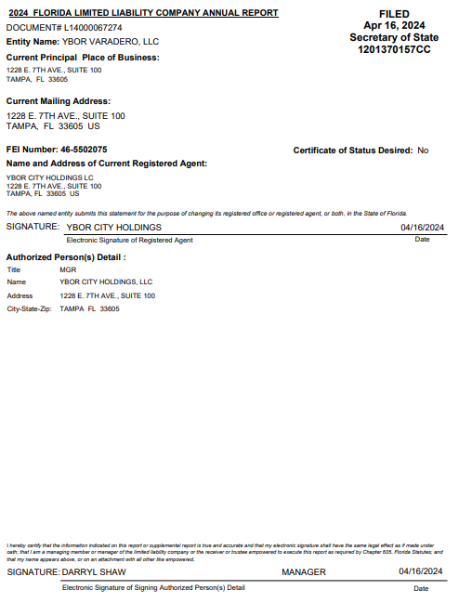
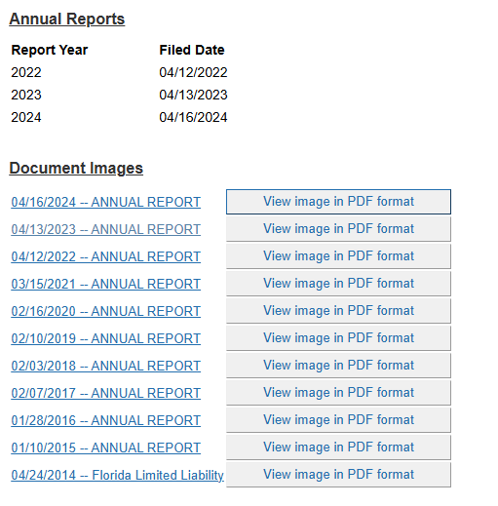



Notes:
Here we are searching by the name of the LLC to find a person to contact and possibly call for more information about the sale.
This is an example of the steps Property Appraiser might take to qualify sale of property and to decide to include or exclude it from the analysis.
So we found a name – Darryl Shaw.

Slide 11

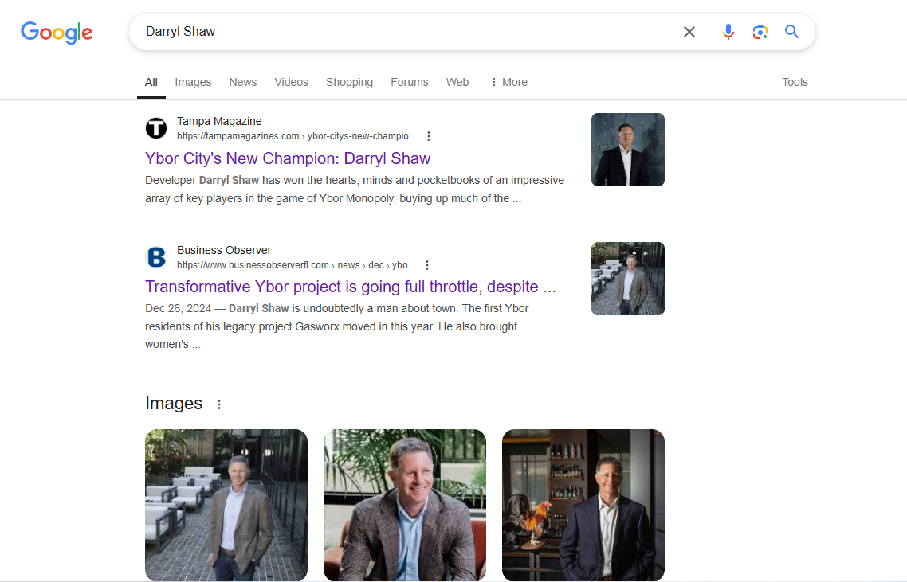

Notes:
I did not know who he was so I used Google to find out.
He is the Tampa Bay Developer and has plans for the Ybor City Harbor Area. The renderings of the project is beautiful.
We might want to contact him about the 2014 Sale and ask if it was an arms-length transaction.

Slide 12
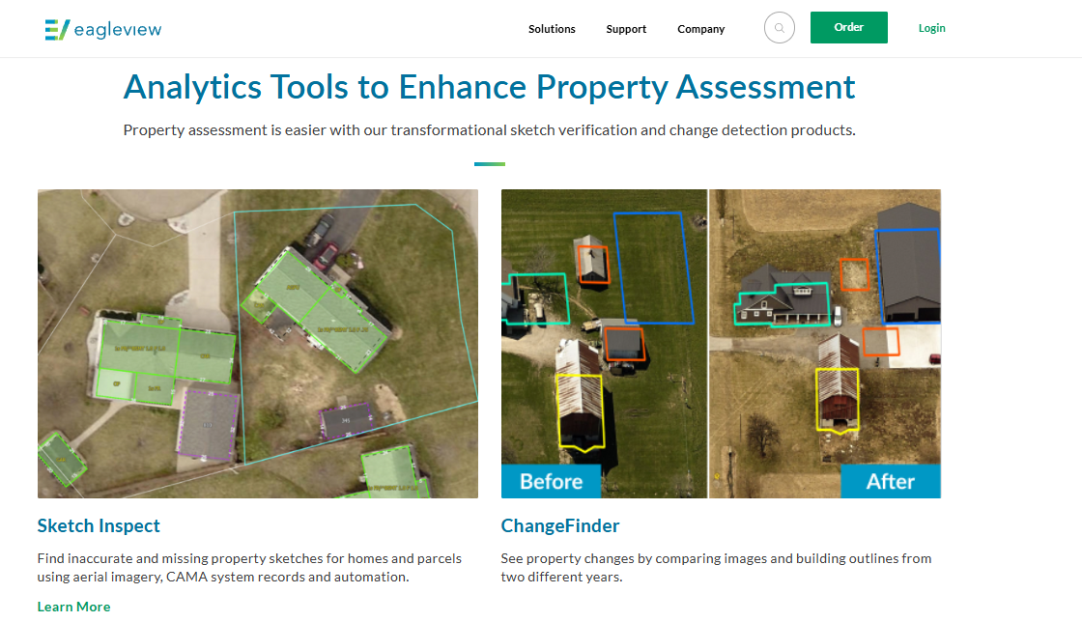



Notes:
Here is the example, of how property changes year to year.

Slide 13
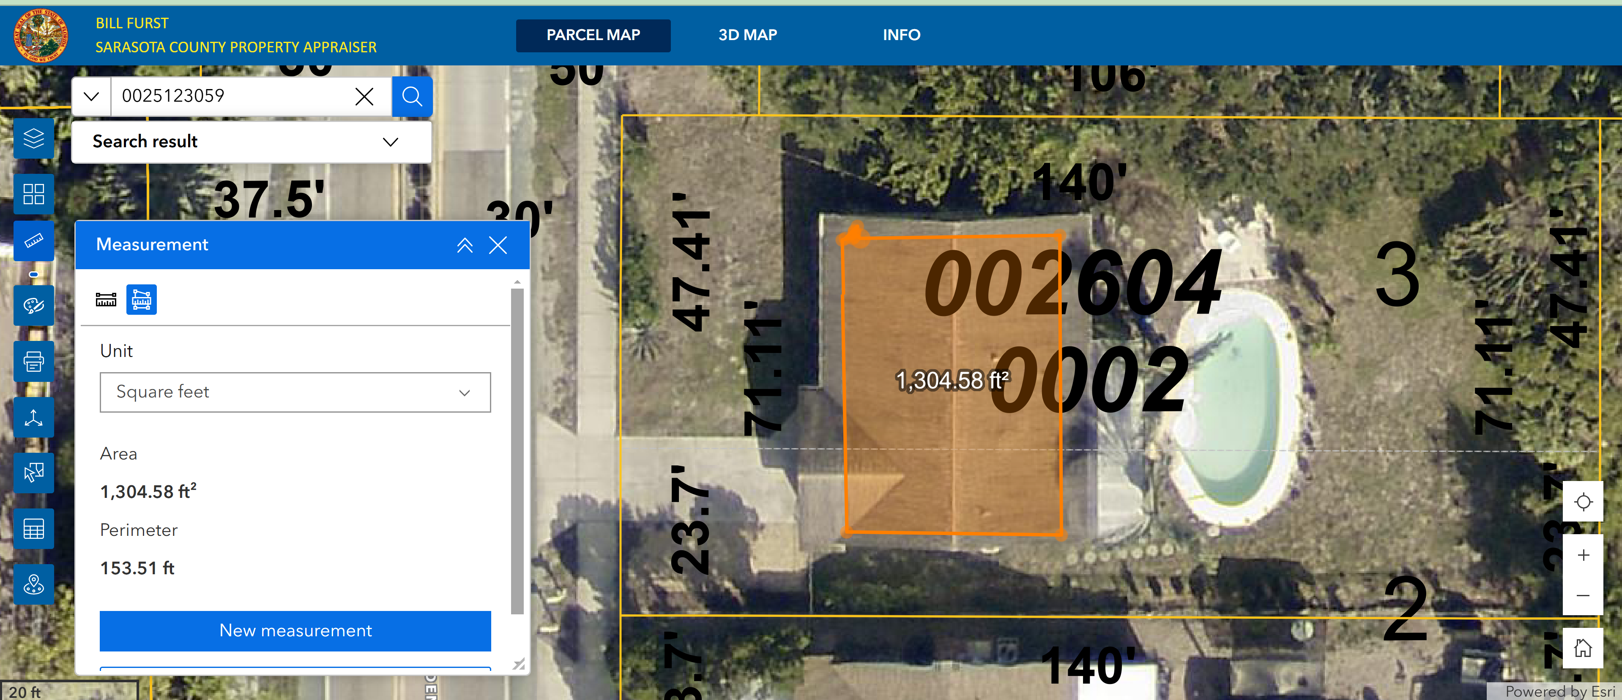
Orthographic View
Notes:
Here is the example of the Orthographic View, where we can measure areas, heights and review the changes of the property over time. There is a company which flies the plane two times a year on the sunny day and take pictures of entire county. They use special software to combine pictures in the special way.
These areal views help a lot to keep records accurate and up to date.

Slide 14
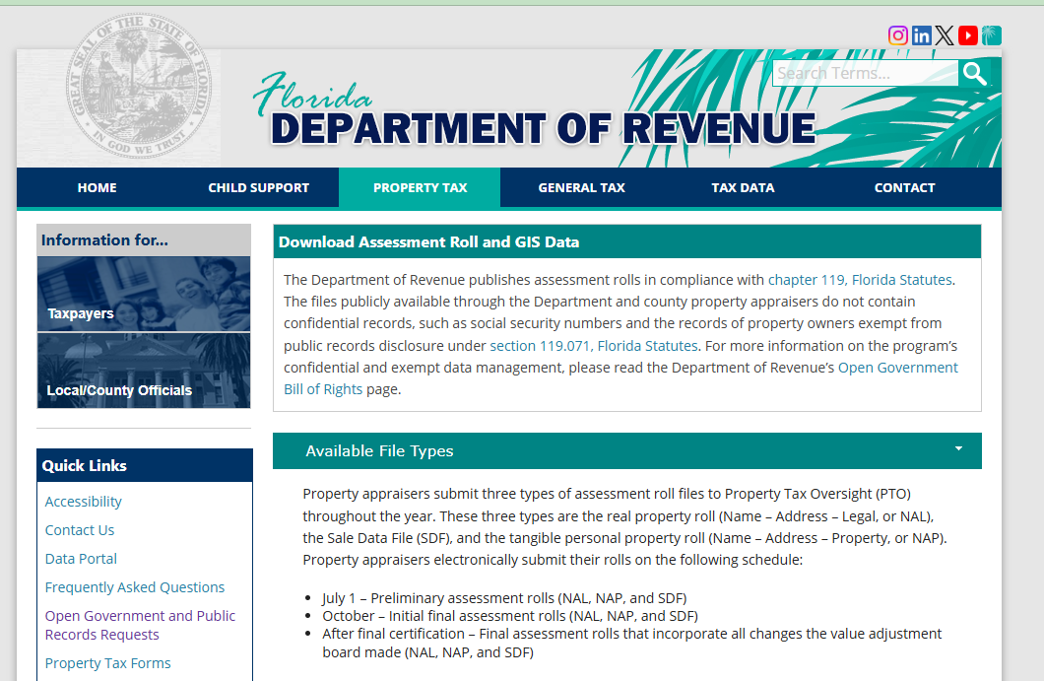

Slide 15
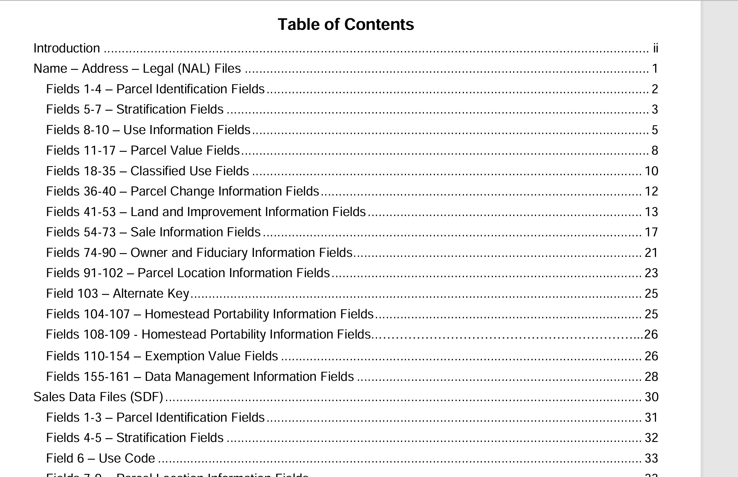
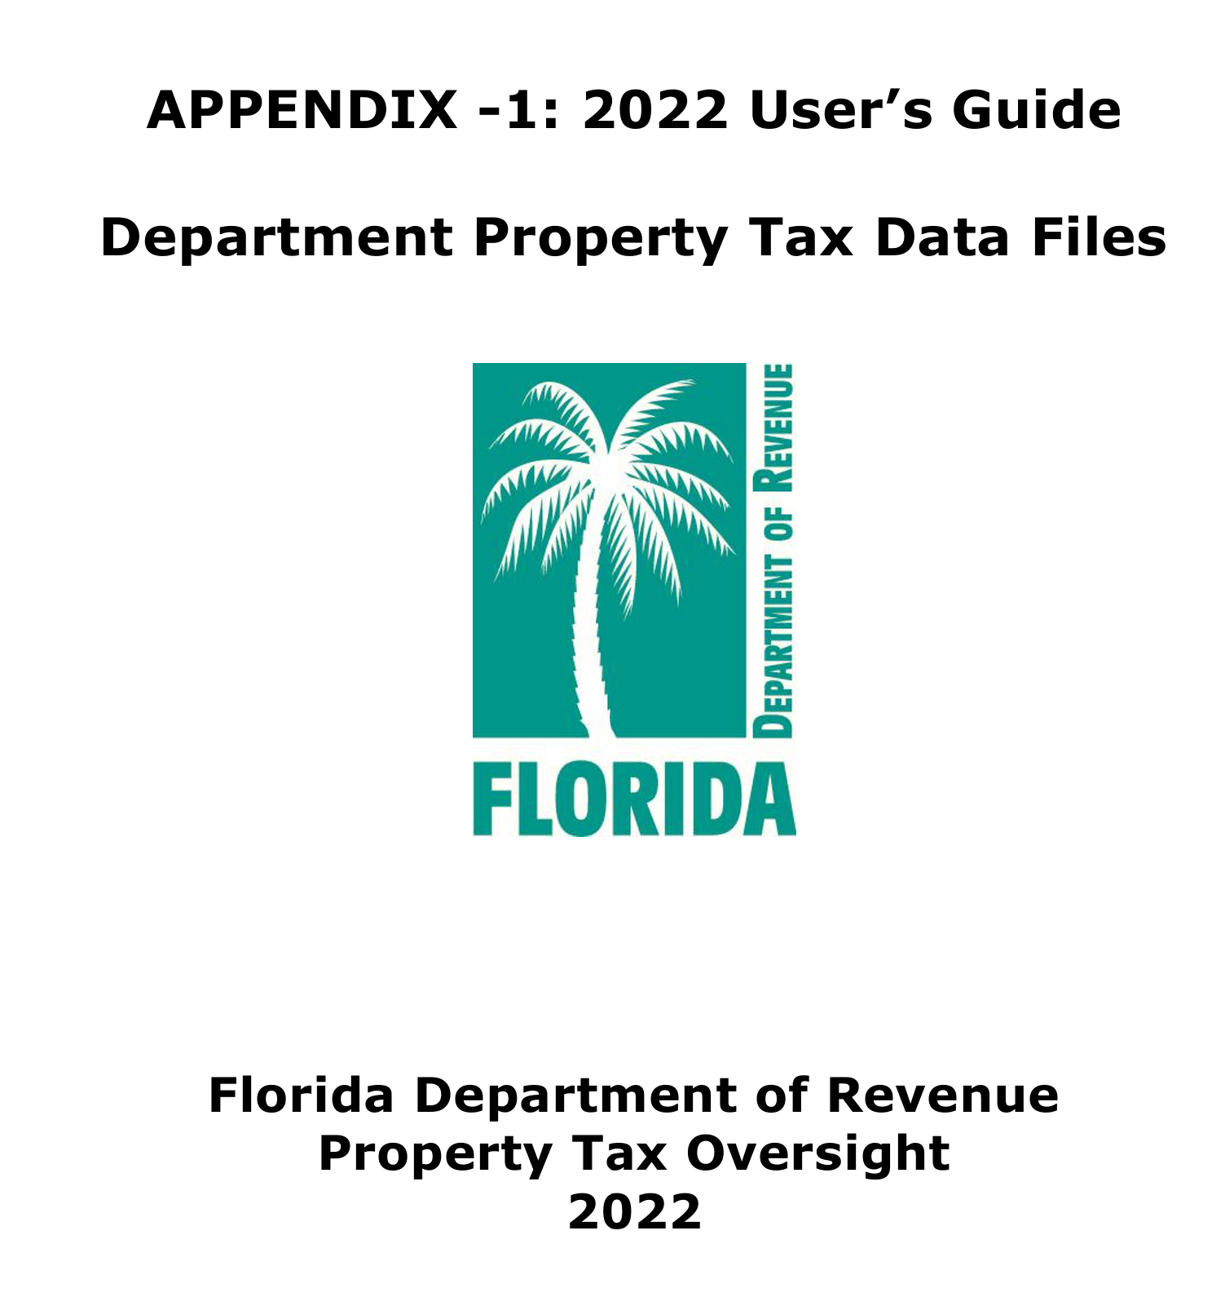

Data set comes with User’s Guide!
Notes:
Here is the screen shot of the User’s Guide. The guide has definitions of each data point. So the each county have to follow these guidelines and the aggregate data set which was collected by each county will be uniform. This is a big undertaking. Imagine each property in Florida has to be described in the similar way.

Slide 16
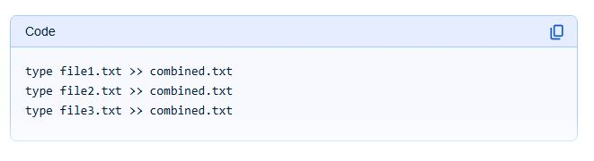
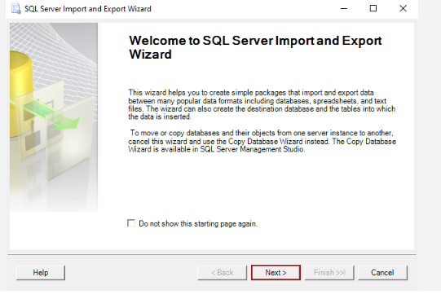
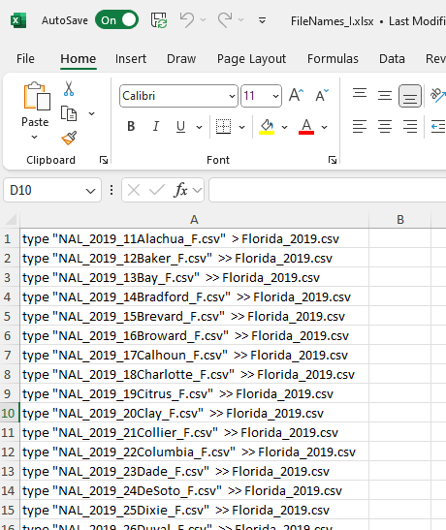

Importing Data into Database
Notes:
My second challenge was to import all data into SQL Server. I also did not wanted to import 804 files one file at the time.
At the time, I was learning basics of command prompt and remembered the append command double greater sign.
This was an aha moment for me!
I have used command prompt to append each county into combined file for each year and ended up with only 12 files which I could import into SQL Server.
Today, I can think of several ways to do this better.

Slide 17
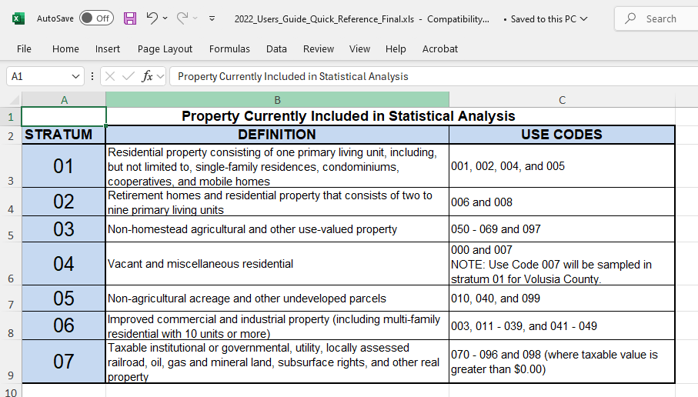

User’s Guide comes in Excel format also!
Notes:
We will be focusing on the Single Family Residences which is coded as – 001

Slide 18
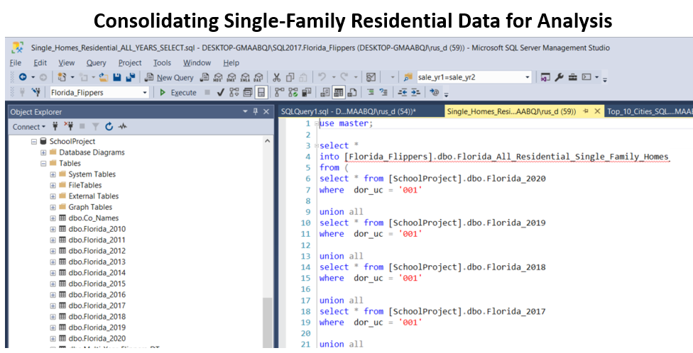
Notes:
Once I have all data in SQL Server I am tempted to say that this was the most difficult part of the project. But I have found out that this was just the beginning and the most difficult part was to find patterns and insights which are true and could be acted on.

Slide 19
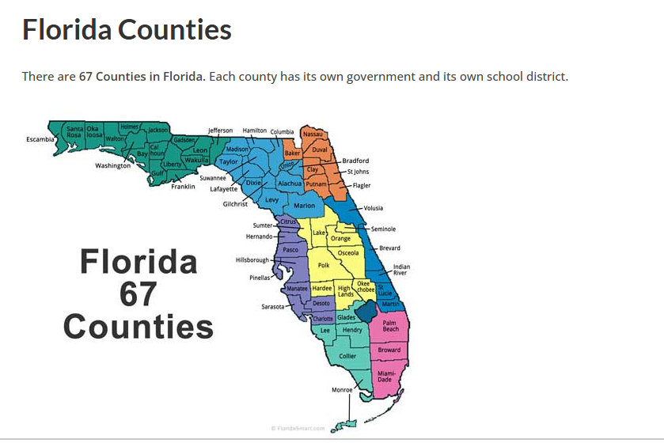
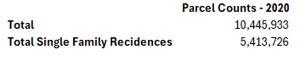
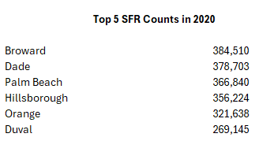
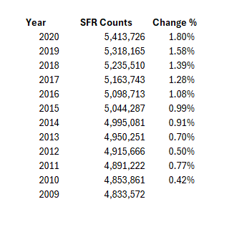
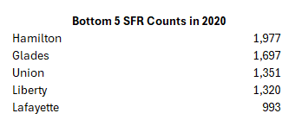
What other questions can be asked of the dataset?

Slide 20
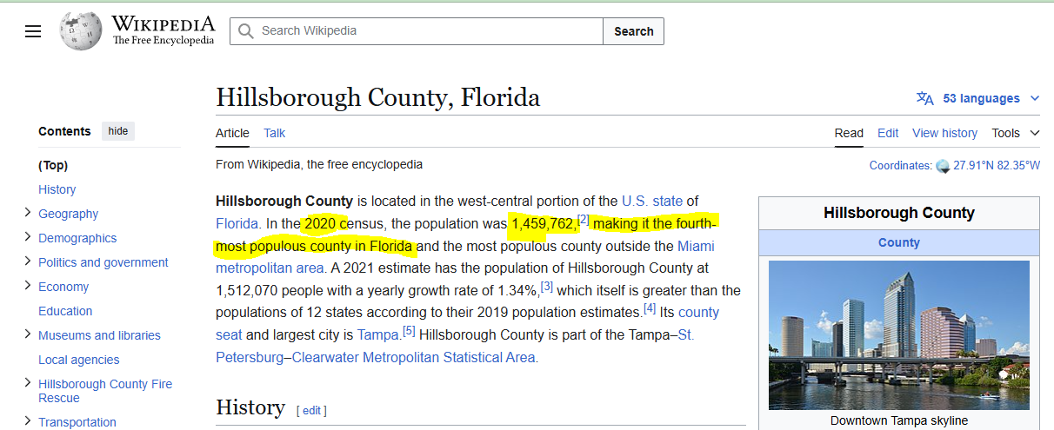


Slide 21
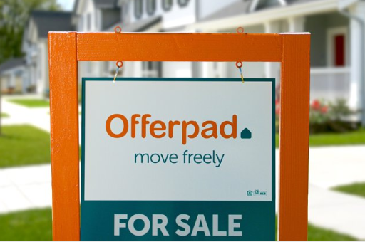
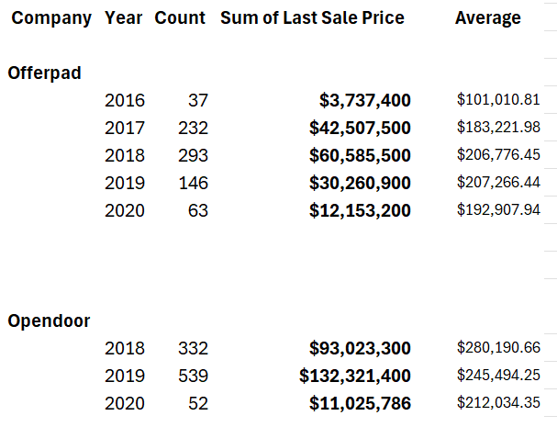

“Instant Buyer” owned property Counts in Florida as of January 1st of each year

Slide 22

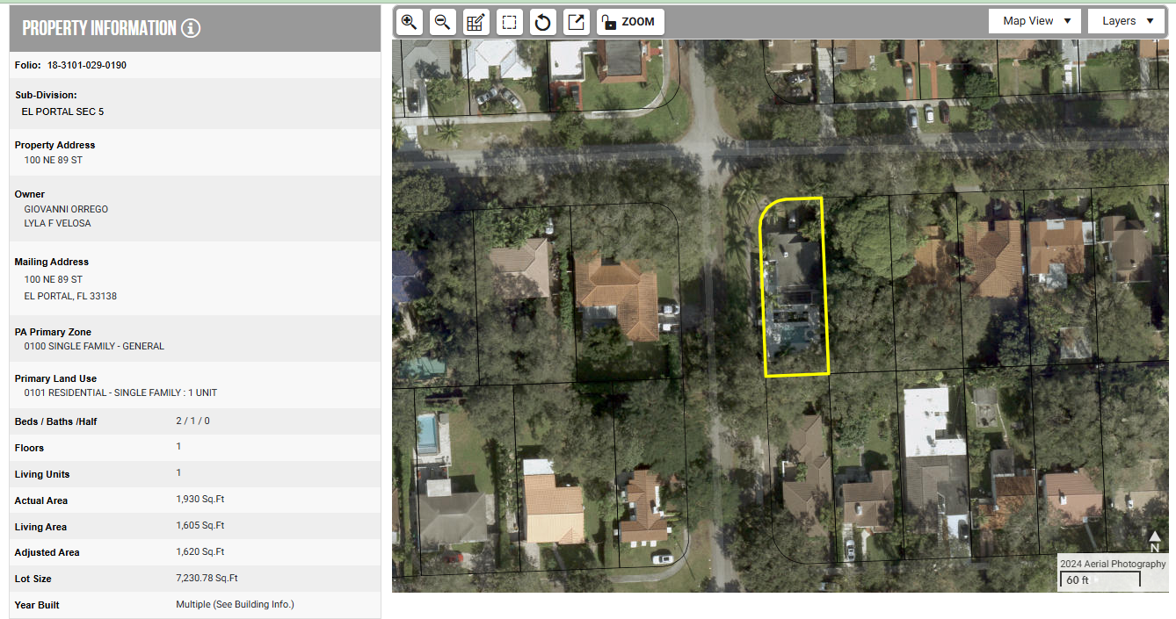
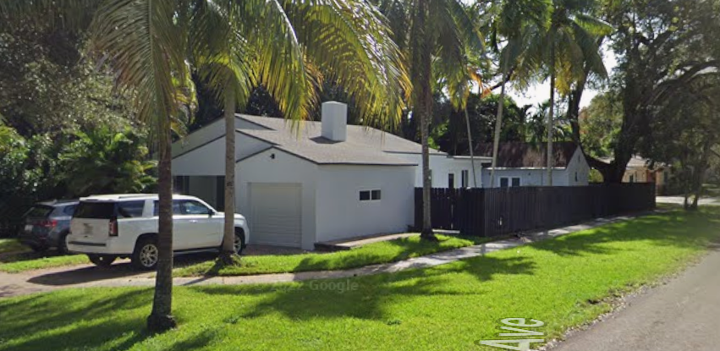
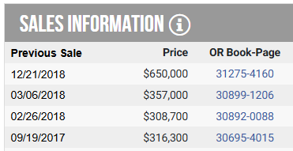

Example of the Profit
Google Street View Nov 2022

Slide 23

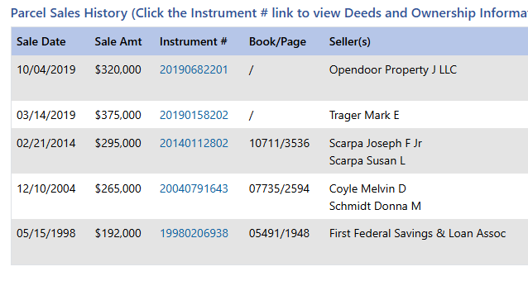
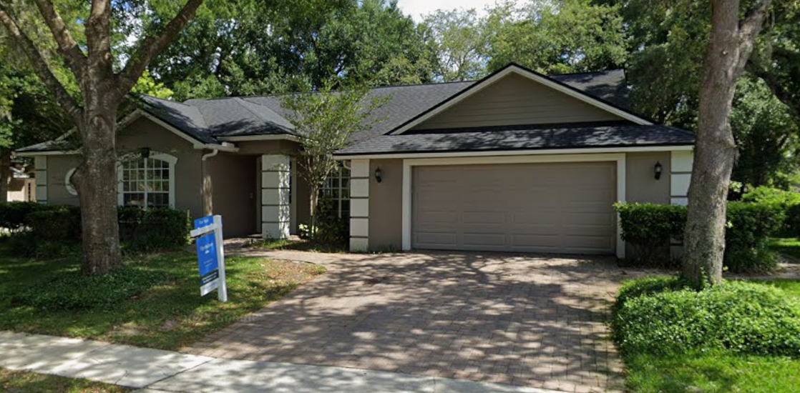
Example of the Loss
Google Street View May 2019

Slide 24
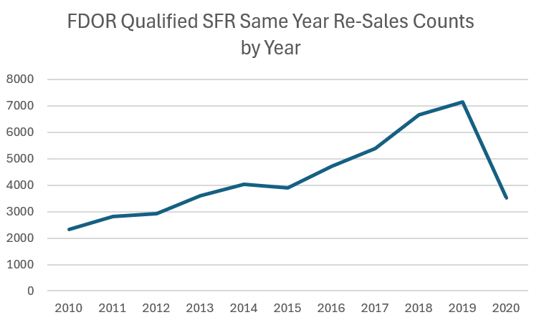
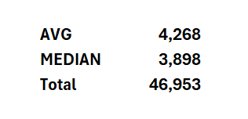

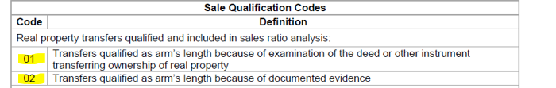

Slide 25
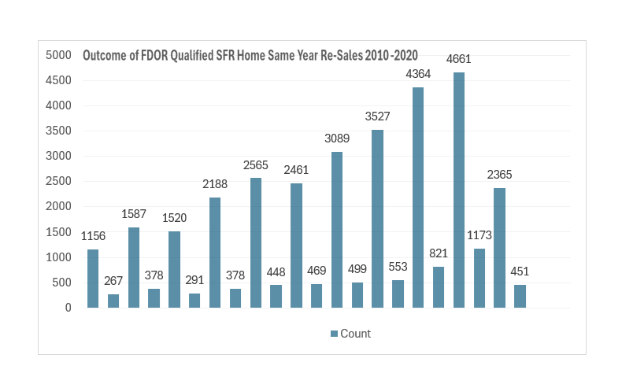
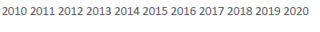

Slide 26

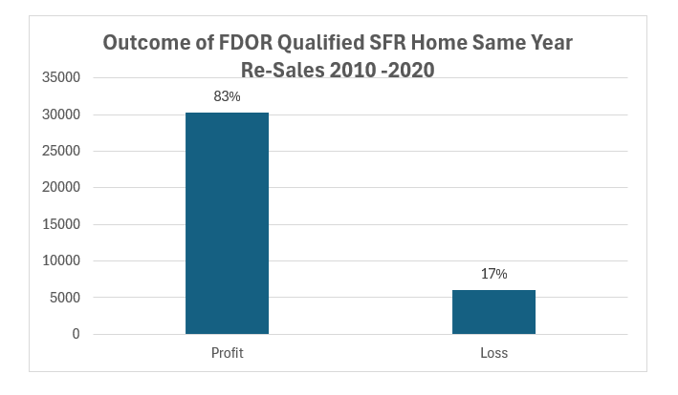
* Sale price increases below 3.5% were classified as losses to reflect financing and closing costs

Slide 27
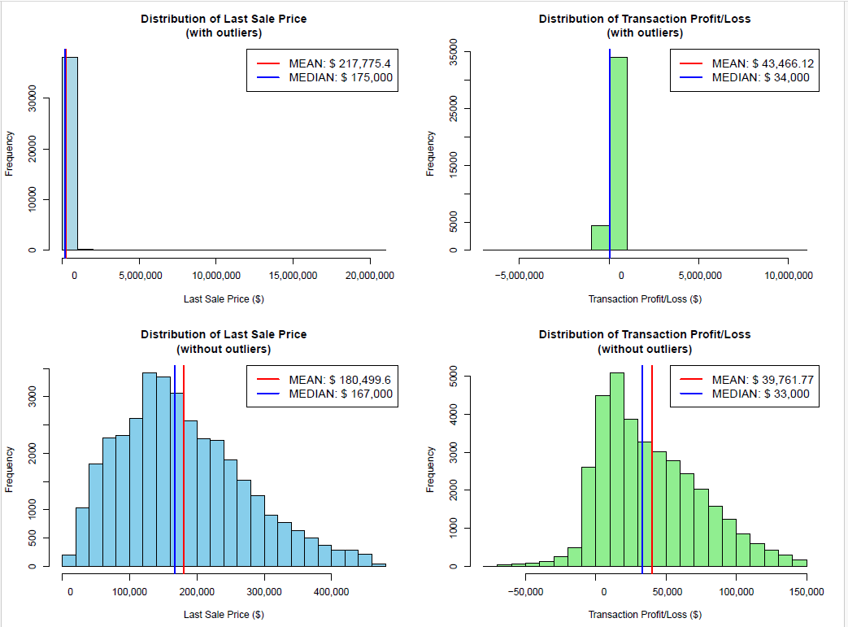

Normalizing Data

Slide 28
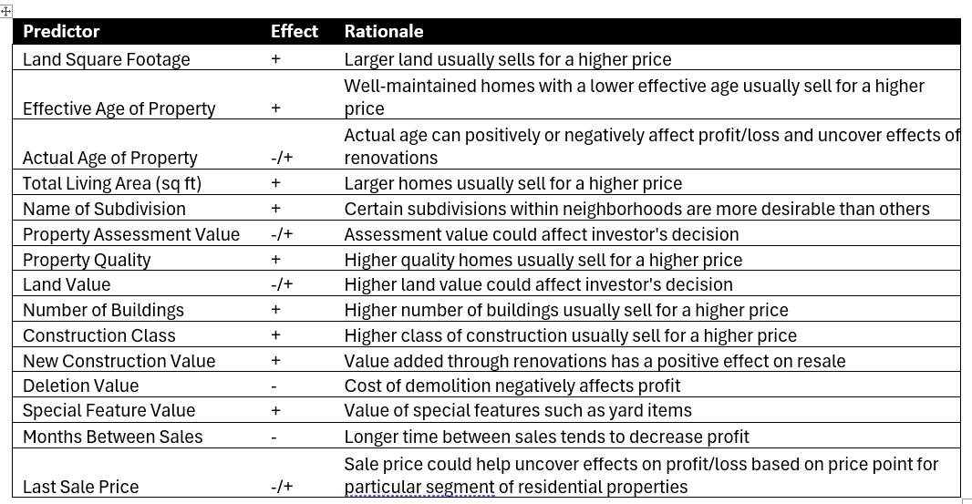

Slide 29


Data Preparation
Dataset Dimensions:
FDOR
123 Columns
38,506 rows
OUR DATASET
16 columns
38,506 rows
Train/Test Split:
70% Training Set: 26,954 rows
30% Test Set: rows: 11,552 rows
Multicollinearity Reduction
Removed -
Removed -

Slide 30



Feature Creation I

Slide 31


Feature Creation II

Slide 32

Feature Creation III
Name of Subdivision transformed
Counted how many homes had losses in each subdivision
Calculated: (Homes with losses) ÷ (Total homes in subdivision)
For small subdivisions (fewer than 5 homes), used overall average (16.9%)
Each property got its subdivision's score as its "location risk"

Slide 33







Baseline Accuracy:
Result: 83%

Slide 34



Conclusion

Slide 35




Nov 10, 2021, 7:00 PM
By Cordilia James
“While Zillow Offers used pricing specialists and agents to resolve discrepancies in buying properties, they mostly relied on the algorithm to get the work done. Zillow ended up paying thousands over market prices, and the company reported $1.2 billion in revenue for its home segment in the third quarter, missing its expectations and losing $328 million”

Slide 36

Thank you

Slide 37


Slide 39










Slide 40


Slide 41









Slide 42


Slide 43
Three Models: Logistic Regression, Decision Tree and Random Forest
Model I: Logistic Regression – Accuracy 80% on the Test Data set
Feature Importance:
Highest coefficient – for variable Short Legal Description of Subdivision – 2.42 with Proportion of Loss outcomes of 0.92
Lowest coefficient – for variable Deletion Value – (-16.75) with Proportion of Loss outcomes of 0
Model II: Decision Tree – Accuracy 83% on the Test Data set
Feature Importance: Highest Importance Score for the variable Month Difference – 0.75
Model III: Random Forest – Accuracy 84% on the Test Data set
Feature Importance: Highest Importance Score for the variable Month Difference – 0.13
Baseline Accuracy – 78%

Slide 44
Enhancements & Extensions for the future research
Study focused on same year SFR home re-sales and further work can be beneficial to look at re-sales which occur within 365-day period
Study did not separated accidental and intentional same year re-sales, further work can be done to focus on only intentional same year re-sales
New data sources can be combined to enhance explain ability of the models. Ex: Traffic counts, School Ratings, demographics etc.
Compiled data from FDOR contains commercial real estate information and same year re-sales of commercial properties can be analyzed. Ex: Gas stations, Apartments, Fast Foods etc.

Slide 45
Git Hub Repository
Full Report in MS Word and PDF formats
Data Source Descriptions in MS Excel, MS Word and PDF formats
Data Set Inputs: Full and 1000 records in CSV formats
Jupyter Notebooks with Python and R code for Data Processing, Model Creation, Model Evaluations, Feature Importance
Git hub Repository - https://github.com/RusUsf/Integrative_Program_Project_Cohort_2022_MSBAIS

Slide 46
References
Silberschatz, Abraham et al., Database Systems Concepts. Seventh Ed., McGraw-Hill Education., 2020
Harrison, Matt. Machine Learning Pocket Reference Working With Structured Data in Python,
O’Reily Media, Inc., 2019
Geron, Aurelien. Hands-on Machine Learning with Scikit-Learn, Keras & TensorFlow Concepts, Tools, and Techniques to Build Intelligent Systems. Third ed., O’Reily Media, Inc., 2022
Bhattacherjee, Anol. Social Science Research: Principles. Second ed., Methods, and Practices.,
University of South Florida, 2012

